Slide 1
Stacks
Lecture 4

Slide 2
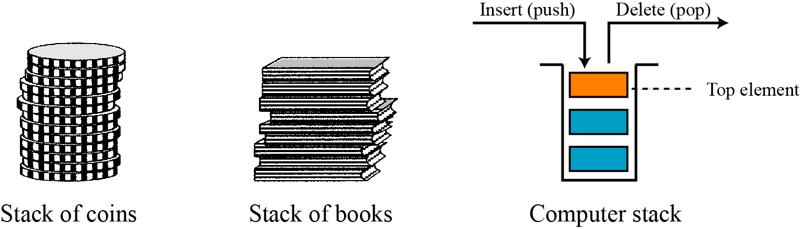
Stacks
What is a Stack?
A stack is an example of a data structure
A method of organizing data
Defined structure and operations
A stack is a data structure of ordered items such that items can be inserted and removed only at one end.
Stacks typically used for temporary storage of data.
A stack is a LIFO (Last-In/First-Out) data structure.
A stack is sometimes also called a pushdown store.

Slide 3
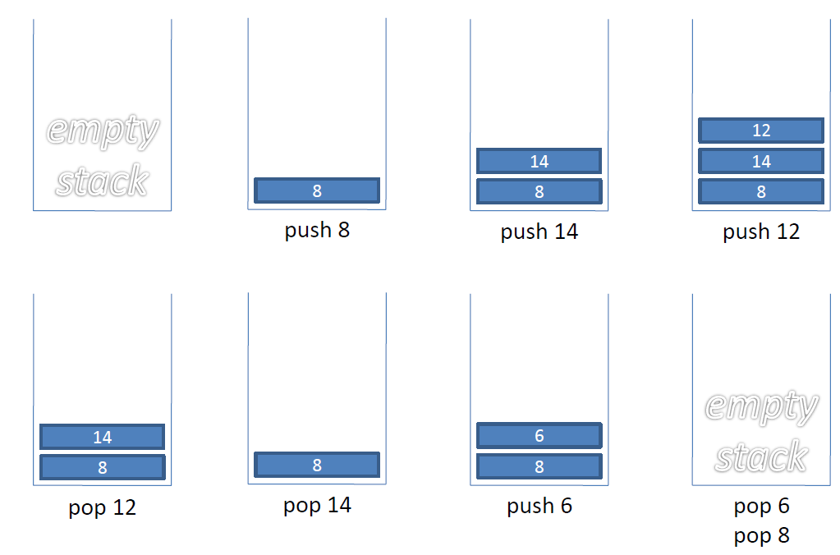
Stacks Example

Slide 4
Stacks
Problem:
What happens if we try to pop an item off the stack when the stack is empty?
This is called a stack underflow. The pop method needs some way of telling us that this has happened.

Slide 5
Exceptions
Attempting the execution of an operation of ADT may sometimes cause an error condition, called an exception.
Exceptions are said to be “thrown” by an operation that cannot be executed.
In the Stack ADT, operations pop and top cannot be performed if the stack is empty.
Attempting the execution of pop or top on an empty stack throws an EmptyStackException.

Slide 6
Stack Operations
Main stack operations:
push(object): inserts an element.
object pop(): removes and returns the last inserted element.
Auxiliary stack operations:
object top(): returns the last inserted element without removing it.
integer size(): returns the number of elements stored.
boolean isEmpty(): indicates whether no elements are stored.

Slide 7
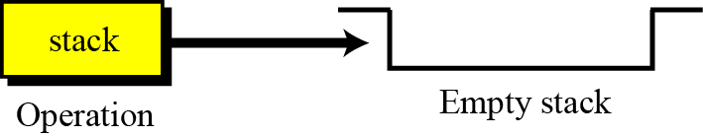
The stack operation
The stack operation creates an empty stack. The following shows the format.

Slide 8
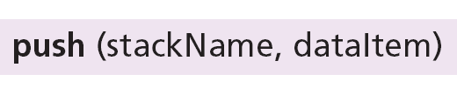
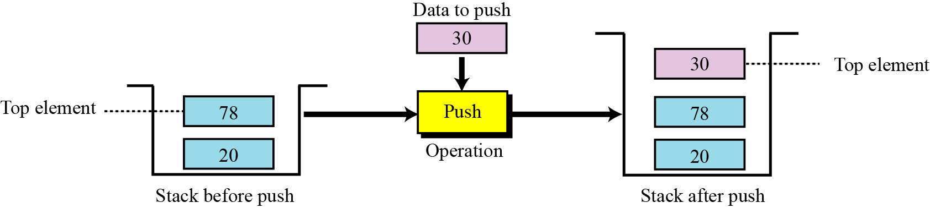
The push operation
The push operation inserts an item at the top of the stack. The following shows the format.
8

Slide 9
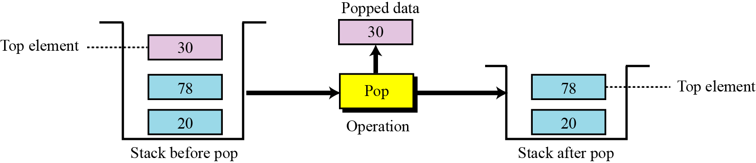
The pop operation
The pop operation deletes the item at the top of the stack. The following shows the format.
9
9

Slide 10
The empty operation
The empty operation checks the status of the stack.
This operation returns true if the stack is empty and false if the stack is not empty.

Slide 11
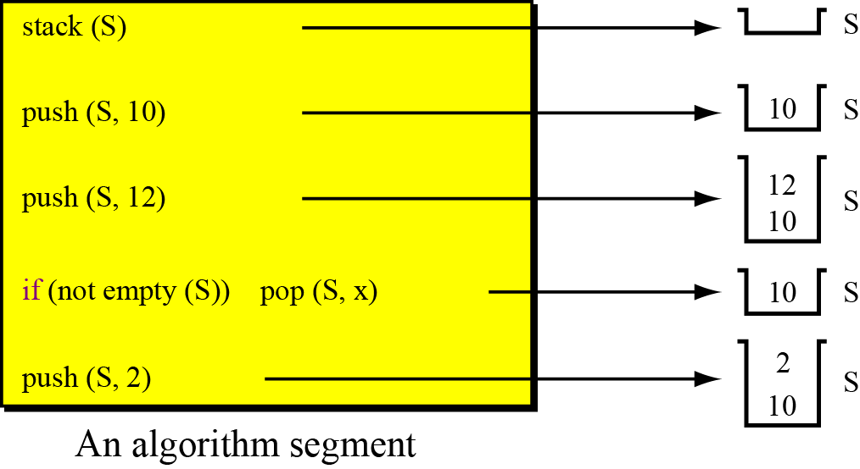
Example
A segment of an algorithm that applies the previously defined operations on a stack S.

Slide 12
Selecting storage structures
Two choices
Select position 0 as top of the stack
Select position 0 as bottom of the stack

Slide 13
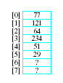
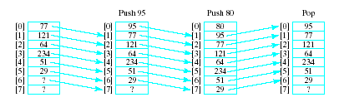
Select position 0 as top of the stack
Model with an array
Let position 0 be top of stack
Problem … consider pushing and popping
Requires much shifting

Slide 14
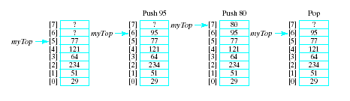
Select position 0 as bottom of the stack
A better approach is to let position 0 be the bottom of the stack
Thus our design will include
An array to hold the stack elements
An integer to indicate the top of the stack

Slide 15
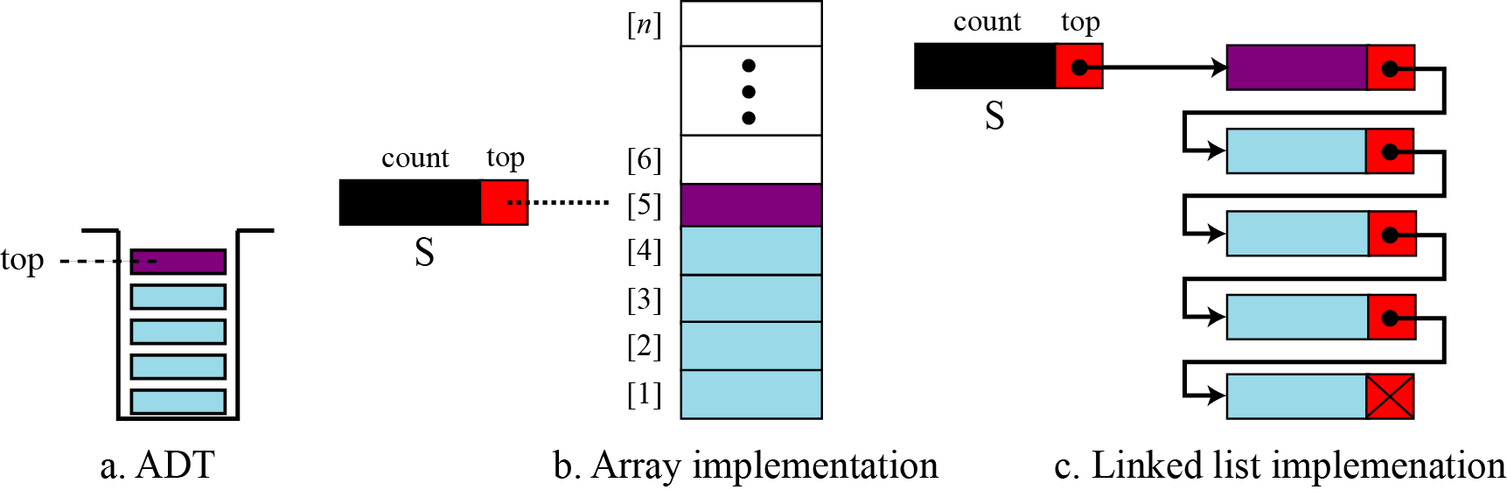
Implementing a Stack
There are two ways we can implement a stack:
Static implementation (Using an array)
Dynamic implementation (Using a linked list)
Notes:
Static implementation using arrays is a very simple technique but is not a flexible way, as the size of the stack has to be declared during the program design, because after that, the size cannot be varied (i.e., increased or decreased). Moreover static implementation is not an efficient method when resource optimization is concerned (i.e., memory utilization). For example a stack is implemented with array size 50. That is before the stack operation begins, memory is allocated for the array of size 50. Now if there are only few elements (say 30) to be stored in the
stack, then rest of the statically allocated memory (in this case 20) will be wasted, on the other hand if there are more number of elements to be stored in the stack (say 60) then we cannot change the size array to increase its capacity.

Slide 16
Implementing a Stack
Implementing a stack using an array is fairly easy.
The bottom of the stack is at data[0]
The top of the stack is at data[numItems-1]
push onto the stack at data[numItems]
pop off of the stack at data[numItems-1]

Slide 17
Implementing a Stack
Implementing a stack using a linked list isn’t that bad either…
Store the items in the stack in a linked list
The top of the stack is the head node, the bottom of the stack is the end of the list
push by adding to the front of the list
pop by removing from the front of the list

Slide 18
Stack (Array Implementation)
Algorithm for push:
Suppose STACK[SIZE] is a one dimensional array for implementing the stack, which will hold the data items. TOP is the pointer that points to the top most element of the stack. Let DATA is the data item to be pushed.
1. If TOP = SIZE – 1, then:
(a) Display “The stack is in overflow condition”
(b) Exit
2. TOP = TOP + 1
3. STACK [TOP] = ITEM
4. Exit

Slide 19
Stack (Array Implementation)
Program for push:
//This function will add/insert an element to Top of the stack
void push()
{
int item;
if (Top == MAXSIZE–1) //if the top pointer already reached the maximum allowed size then
{ //we can say that the stack is full or overflow
printf(“\nThe Stack Is Full”);
getch();
} //Otherwise an element can be added or inserted by incrementing the //stack pointer Top as follows
else
{
printf(“\nEnter The Element To Be Inserted = ”);
scanf(“%d”,&item);
top++;
stack[top] = item;
}
}
Notes:
void push(int value) {
top++;
stack[top] = value;
}

Slide 20
Stack (Array Implementation)
Algorithm for pop:
Suppose STACK[SIZE] is a one dimensional array for implementing the stack, which will hold the data items. TOP is the pointer that points to the top most element of the stack. DATA is the popped (or deleted) data item from the top of the stack.
1. If TOP < 0, then
(a) Display “The Stack is empty”
(b) Exit
2. Else remove the Top most element
3. DATA = STACK[TOP]
4. TOP = TOP – 1
5. Exit

Slide 21
Stack (Array Implementation)
Program for pop:
//This function will delete an element from the Top of the stack
void pop()
{
int item; //If the Top pointer points to NULL, then the stack is empty
if (Top == -1) // that is NO element is there to delete or pop
printf(“\nThe Stack Is Empty”);
//Otherwise the top most element in the stack is popped or deleted by decrementing the Top pointer
else
{
item= stack[top];
Top=top-1;
printf(“\nThe Deleted Element Is = %d”,item);
}
}

Slide 22
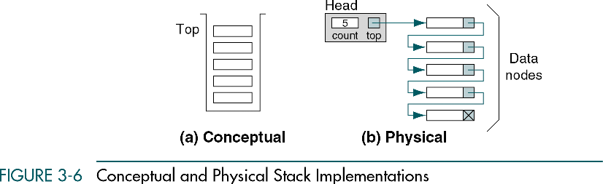
Stack (Linked List Implementation)

Slide 23
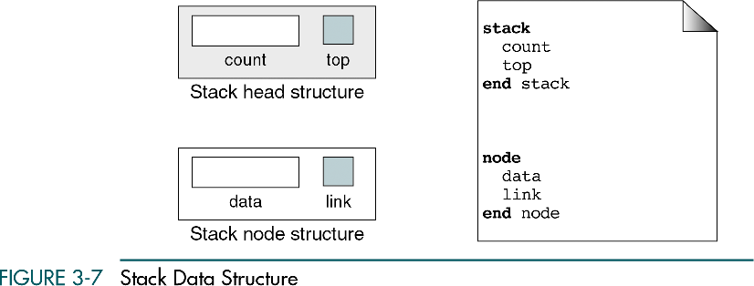
Stack (Linked List Implementation)

Slide 24
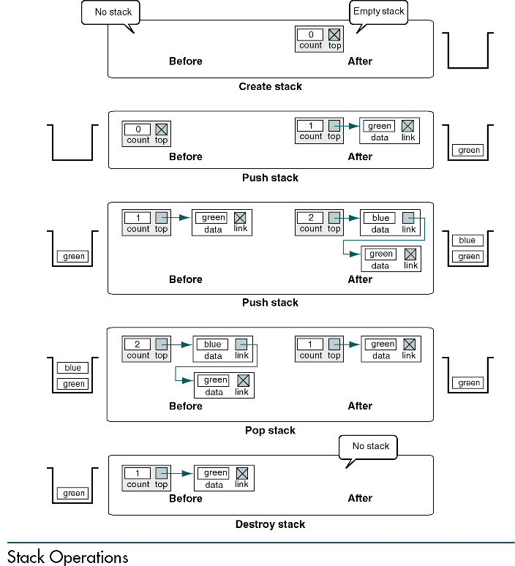
Example

Slide 25
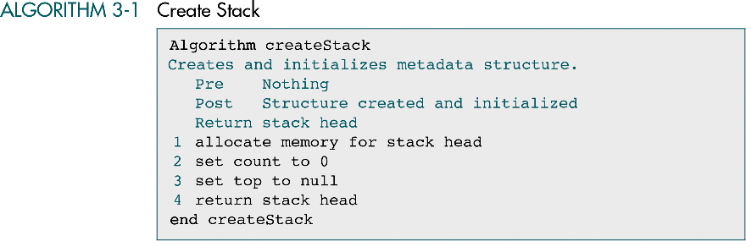

Slide 26
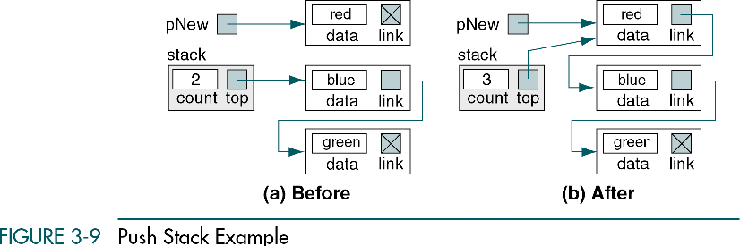

Slide 27
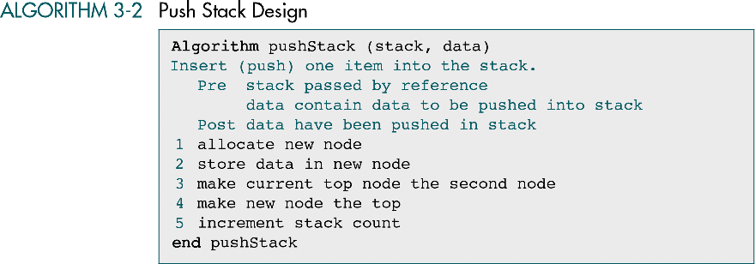

Slide 28
Program to push
void push() {
struct node *ptr;
printf("\n\nEnter ITEM: ");
scanf("%d", &item);
if (top == NULL) {
top = (struct node *)malloc(sizeof(struct node));
top->info = item;
top->link = NULL;
}
else {
ptr = top;
top = (struct node *)malloc(sizeof(struct node));
top->info = item;
top->link = ptr;
}
printf("\nItem inserted: %d\n", item);
}

Slide 29
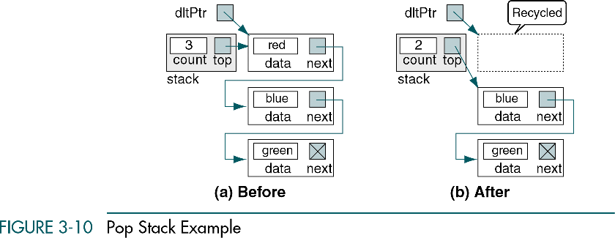

Slide 30
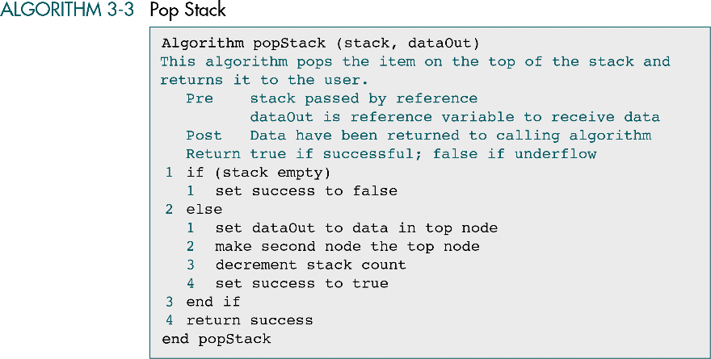

Slide 31
Program to pop
void pop()
{
struct node *ptr;
if (top == NULL)
printf("\n\nStack is empty\n");
else
{
ptr = top;
item = top->info;
top = top->link;
free(ptr);
printf("\n\nItem deleted: %d", item);
}
}

Slide 32
Traversing
void display()
{
struct node *ptr;
if (top == NULL)
printf("\n\nStack is empty\n");
else
{
ptr = top;
while(ptr != NULL)
{
printf("\n\n%d", ptr->info);
ptr = ptr->link;
}

Slide 33
Applications of Stacks
Stack applications can be classified into four broad categories: reversing data, pairing data, postponing data usage and backtracking steps.
Direct applications
Page-visited history in a Web browser
Undo sequence in a text editor
Chain of method calls in the Java Virtual Machine or C++ runtime environment
Program execution
Parsing
Evaluating postfix expressions
Indirect applications
Auxiliary data structure for algorithms
Component of other data structures

Slide 34
Reversing data items
Reversing data items requires that a given set of data items be reordered so that the first and last items are exchanged, with all of the positions between the first and last also being relatively exchanged. For example, the list (2, 4, 7, 1, 6, 8) becomes (8, 6, 1, 7, 4, 2).

Slide 35
Pairing data items
We often need to pair some characters in an expression. For example, when we write a mathematical expression in a computer language, we often need to use parentheses to change the precedence of operators. The following two expressions are evaluated differently because of the parentheses in the second expression:
When we type an expression with a lot of parentheses, we often forget to pair the parentheses. One of the duties of a compiler is to do the checking for us. The compiler uses a stack to check that all opening parentheses are paired with a closing parentheses.

Slide 36
Example
Algorithm to check if all opening parentheses are paired with a closing parenthesis.

Slide 37
Example (Continued)

Slide 38
Applications of Stacks
RECURSION
Recursion occurs when a function is called by itself repeatedly; the function is called recursive function. The general algorithm model for any recursive function contains the following steps:
Prologue: Save the parameters, local variables, and return address.
Body: If the base criterion has been reached, then perform the final computation and go to step 3; otherwise, perform the partial computation and go to step 1 (initiate a recursive call).
Epilogue: Restore the most recently saved parameters, local variables, and return address.

Slide 39
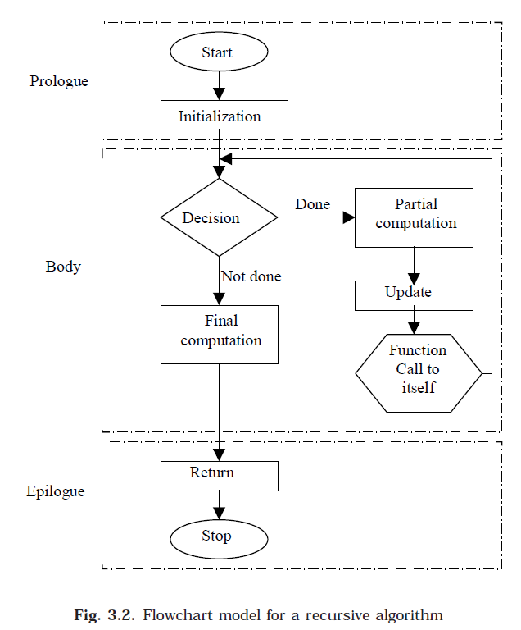
RECURSION

Slide 40
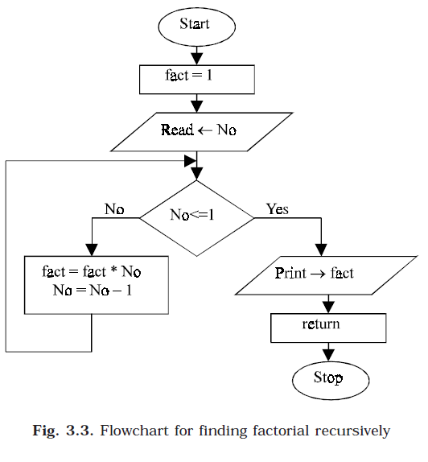
RECURSION Example

Slide 41
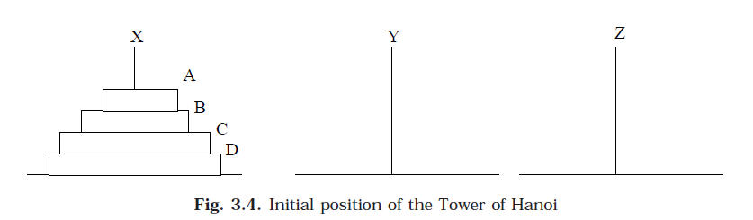
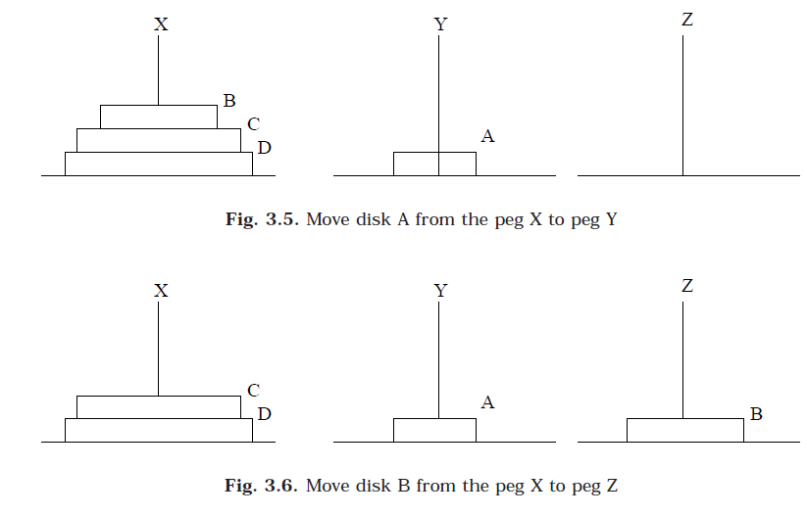
TOWER OF HANOI
Notes:
The initial setup of the problem is shown here. Here three pegs (or towers) X, Y and Z exists. There will be four different sized disks, say A, B, C and D. Each disk has a hole in the center so that it can be stacked on any of the pegs. At the beginning, the disks are stacked on the X peg, that is the largest sized disk on the bottom and the smallest sized disk on top as shown in Fig. 3.4.
Tower of Hanoi is a mathematical puzzle invented by a French Mathematician Edouard Lucas in 1883.
The game starts by having few discs stacked in increasing order of size. The number of discs can vary, but there are only three pegs.

Slide 42
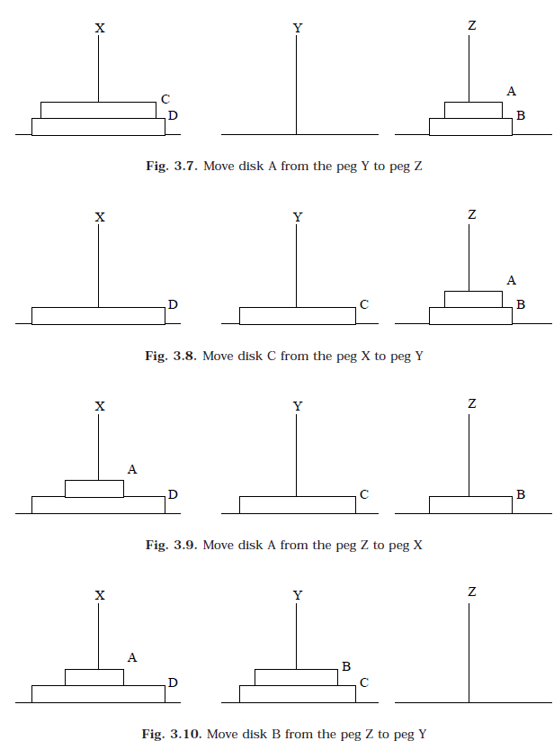
TOWER OF HANOI

Slide 43
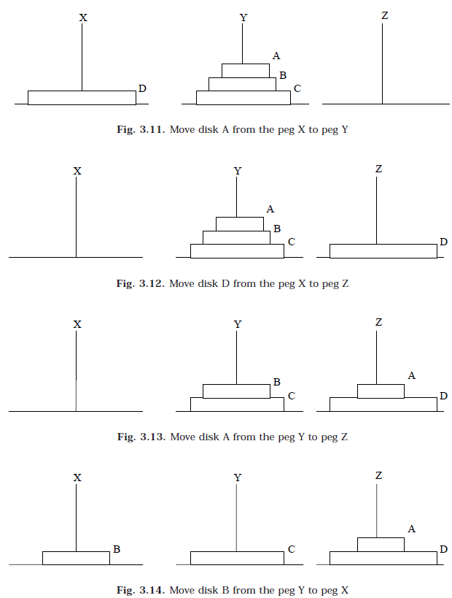
TOWER OF HANOI

Slide 44
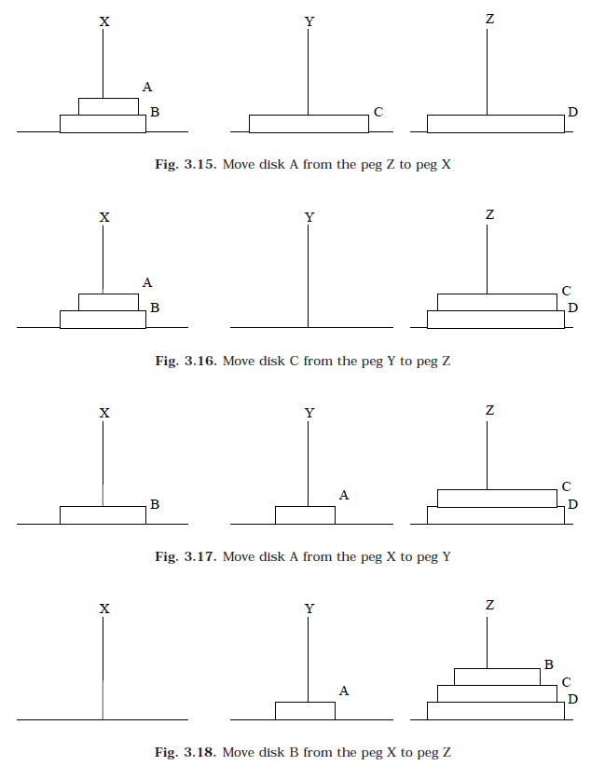
TOWER OF HANOI

Slide 45
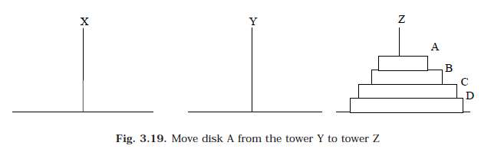
TOWER OF HANOI

Slide 46
TOWER OF HANOI
Recursive Solution for the Tower of Hanoi with algorithm
Let’s call the three peg Src(Source), Aux(Auxiliary) and st(Destination).
Move the top N – 1 disks from the Source to Auxiliary tower
Move the Nth disk from Source to Destination tower
Move the N – 1 disks from Auxiliary tower to Destination tower. Transferring the top N – 1 disks from Source to Auxiliary tower can again be thought of as a fresh problem and can be solved in the same manner. So once you master solving Tower of Hanoi with three disks, you can solve it with any number of disks with the above algorithm.

Slide 47
TOWER OF HANOI
Explicit Pattern
Number of Disks Number of Moves 1 1 2 3 3 7 4 15 5 31
Powers of two help reveal the pattern:
Number of Disks (n) Number of Moves 1 2^1 - 1 = 2 - 1 = 1 2 2^2 - 1 = 4 - 1 = 3 3 2^3 - 1 = 8 - 1 = 7 4 2^4 - 1 = 16 - 1 = 15 5 2^5 - 1 = 32 - 1 = 31

Slide 48
EXPRESSION
Another application of stack is calculation of postfix expression. There are basically three types of notation for an expression (mathematical expression; An expression is defined as the number of operands or data items combined with several operators.)
Infix notation
Prefix notation
Postfix notation

Slide 49
EXPRESSION
1. Infix notation
The infix notation is what we come across in our general mathematics, where the operator is written in-between the operands. For example : The expression to add two numbers A and B is written in infix notation as:
A + B
2. Prefix notation
The prefix notation is a notation in which the operator(s) is written before the operands, it is also called polish notation in the honor of the polish mathematician Jan Lukasiewicz who developed this notation. The same expression when written in prefix notation looks like:
+ A B

Slide 50
EXPRESSION
3. Postfix notation
In the postfix notation the operator(s) are written after the operands, so it is called the postfix notation (post means after), it is also known as suffix notation or reverse polish notation. The above expression if written in postfix expression looks like:
A B +

Slide 51
EXPRESSION
The method of converting infix expression A + B * C to postfix form is:
A + B * C Infix Form
A + (B * C) Parenthesized expression
A + (B C *) Convert the multiplication
A (B C *) + Convert the addition
A B C * + Postfix form
The rules to be remembered during infix to postfix conversion are:
Parenthesize the expression starting from left to light.
During parenthesizing the expression, the operands associated with operator having higher precedence are first parenthesized. For example in the above expression B * C is parenthesized first before A + B.
The sub-expression (part of expression), which has been converted into postfix, is to be treated as single operand.
Once the expression is converted to postfix form, remove the parenthesis.

Slide 52
Example 1
Give postfix form for A + [ (B + C) + (D + E) * F ] / G
Solution. Evaluation order is
A + { [ (BC +) + (DE +) * F ] / G}
A + { [ (BC +) + (DE + F *] / G}
A + { [ (BC + (DE + F * +] / G} .
A + [ BC + DE + F *+ G / ]
ABC + DE + F * + G / + Postfix Form

Slide 53
Example 2
Give postfix form for (A + B) * C / D + E ^ A / B
Solution. Evaluation order is
[(AB + ) * C / D ] + [ (EA ^) / B ]
[(AB + ) * C / D ] + [ (EA ^) B / ]
[(AB + ) C * D / ] + [ (EA ^) B / ]
(AB + ) C * D / (EA ^) B / +
AB + C * D / EA ^ B / + Postfix Form

Slide 54
Algorithm
1. Push “(” onto stack, and add“)” to the end of P.
2. Scan P from left to right and repeat Steps 3 to 6 for each element of P until the stack is empty.
3. If an operand is encountered, add it to Q.
4. If a left parenthesis is encountered, push it onto stack.
5. If an operator ⊗ is encountered, then:
(a) Repeatedly pop from stack and add P each operator (on the top of stack),
which has the same precedence as, or higher precedence than ⊗.
(b) Add ⊗ to stack.
6. If a right parenthesis is encountered, then:
(a) Repeatedly pop from stack and add to P (on the top of stack until a left
parenthesis is encountered.
(b) Remove the left parenthesis. [Do not add the left parenthesis to P.]
7. Exit.

Slide 55


Example 3
Infix String : a+b*c-d
Initially the Stack is empty and our Postfix string has no characters. Now, the first character scanned is 'a'. 'a' is added to the Postfix string. The next character scanned is '+'. Being an operator, it is pushed to the stack.
Next character scanned is 'b' which will be placed in the Postfix string. Next character is '*' which is an operator. Now, the top element of the stack is '+' which has lower precedence than '*', so '*' will be pushed to the stack.
Postfix String
Stack
Postfix String
Stack

Slide 56


Example 3
The next character is 'c' which is placed in the Postfix string. Next character scanned is '-'. The topmost character in the stack is '*' which has a higher precedence than '-'. Thus '*' will be popped out from the stack and added to the Postfix string. Even now the stack is not empty. Now the topmost element of the stack is '+' which has equal priority to '-'. So pop the '+' from the stack and add it to the Postfix string. The '-' will be pushed to the stack.
Next character is 'd' which is added to Postfix string. Now all characters have been scanned so we must pop the remaining elements from the stack and add it to the Postfix string. At this stage we have only a '-' in the stack. It is popped out and added to the Postfix string. So, after all characters are scanned, this is how the stack and Postfix string will be :
Postfix String
Stack
Postfix String
Stack

Slide 57
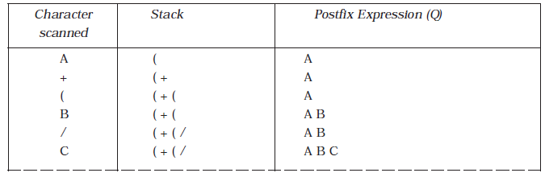
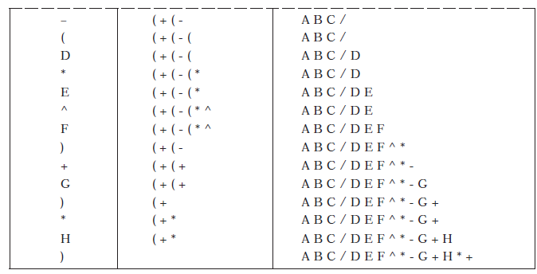
Applications of Stacks
Consider the following arithmetic infix expression P
P = A + ( B / C - ( D * E ^ F ) + G ) * H

Slide 58
Sources used
Lectures by Mr. Mohammad Asad Abbasi

